Slide 1
Preventing Peer-to-Peer Sexual Abuse at Your Organization
Notes:
Purpose of Slide:
This is an opportunity to set the scene, and make sure your staff are ready to engage with an incredibly tough topic.
Talking Points:
Acknowledge that this can be a tough topic, and that some may have personal experience. Give permission for people to step away if needed, and encourage them to seek help.
Explain to staff that this is a critically important part of doing their job, and part of their professional and moral responsibility.
Emphasize that what they learn today may help prevent life-altering abuse.

Slide 2
What You Will Learn
Where and how does it happen?
How can I prevent it?
How should I respond to it?
Notes:
Purpose of Slide:
Establish a specific and measurable set of goals for the end of the training.
Talking Points:
Run through the three main objectives, so they understand what they should be able to take away by the end of the training.

Slide 3
What is peer-to-peer abuse?
Sexual activity
Inappropriate touching
Pornography
Sexting
Sexualized language
Even ‘experimentation’
Notes:
Purpose of Slide:
Be sure staff understand the full range of activities that may constitute peer-to-peer abuse.
Talking Points:
Point out wide range of types and severity of abuse.
Emphasize that while it might involve physical sex acts, it also may not.
Emphasize that porn, sexting, even sexualized language are all potentially abusive.

Slide 4
The Reality
The Assumption
All abusers are adults
All are seasoned predators
We can keep them out
"It can’t happen here"
P2P abuse just as common
Often starts with bullying
Doesn’t have to involve touch
Assume it is happening now
Notes:
Purpose of Slide:
This is an emphasis slide/opportunity to pause and discuss why we must have zero tolerance for all types of sexual activity.
Talking Points:
Acknowledge that no matter the age (3, 8 or 16), any minor engaging in any sexual act with another minor is considered peer-to-peer abuse.
Even what you may think of as teenage ‘exploration’ is to be considered abuse in a youth-serving environment—and cannot be tolerated at your organization.
Optional Discussion Questions:
What would you do if you found a teen couple—who appear to be dating—making out in a back room?
Are there any scenarios that come to mind that you may be doubting if it’s considered abuse or not? (If staff do share a scenario, this is where to reiterate that any form of sexual activity between minors is considered abuse at your organization.)

Slide 5
Minors cannot consent to sexual activity.
Notes:
Purpose of Slide:
Encourage critical reflection of staff’s current preconceptions about abuse—and then expand their understanding of what types of abuse they need to be watching out for.
Talking Points:
Run through assumptions of abuse as adult-to-child, predatory, and something that can be ‘kept out’ with background checks and other measures.
Emphasize that this type of abuse really does happen, but it is not the only type.
Then run through the realities of peer-to-peer abuse—that it appears to be just as common, and that it is often related more to bullying than sex. Remind them that it doesn’t have to involve touch or sex acts.
Encourage staff to understand and believe that abuse could, and probably has, happened or is happening at their organization.
Optional Discussion Questions:
When you thought about abuse before this training, what image came to mind? Keep that in mind as you take this training—and see how it changes.

Slide 6
How does it happen?
Same or different ages
Same or different sexes
Bullying
Coercive behavior
Power imbalances
Notes:
Purpose of Slide:
An opportunity to focus on the key dynamics or factors that are often present when abuse happens, and may contribute to risk.
Talking Points:
Emphasize wide range of participants—ages, genders, etc.
Explain that the key differentiator is bullying and power

Slide 7
It’s not just about sex acts. It’s often an extension of bullying.
Notes:
Purpose of Slide:
This simply is an opportunity to pause and emphasize the point that peer-to-peer abuse is primarily power-driven and is rooted in bullying.
Talking Points:
The primary concern is situations where weaker, younger or less powerful youth are targeted.
If youth are being coerced, and if there is sexual content, then it is potentially abusive and always unacceptable.
Optional Discussion Questions:
What types of power dynamics do you see between youth at our organization that might be problematic? What can we do to mitigate them?

Slide 8
The Reality
The Assumption
Only ‘problem’ youth abuse
We should only worry about ‘severe’ cases
It’s rare and unlikely
60% of Redwoods’ abuse incidents are peer-to-peer
74% involve similar ages (+/- 1 yr)
Incidents are under-reported
Notes:
Purpose of Slide:
This is an option to challenge any sense of safety or complacency.
Talking Points:
Run through assumptions presented on the slide.
Major incidents escalate from minor ones.
Explain that stats are based only on Redwoods investigations—one insurance company that focuses on youth-serving organizations—and is likely an under-reported problem.

Slide 9
Peer-to-peer abuse has happened or is happening.
Notes:
Purpose of Slide:
This is an emphasis slide, to encourage staff to discuss their own attitudes to likelihood of risk.
Talking Points:
The key takeaway is simply that they must assume that it has or is occurring.
Optional Discussion Questions:
Have you seen peer-to-peer abuse at your organization? Could it be happening without you knowing it?

Slide 10
The following examples may be difficult to hear.
Notes:
Talking Points:
Explain to staff that you are now going to run through some examples of peer-to-peer abuse
Recognize that the stories may be difficult to hear
Explain the importance of sharing these stories so that they can work to prevent similar situations
Validate that it is okay if staff members need some time to reflect or compose themselves

Slide 11
Example #1: Unsupervised Bathroom
Three boys, ranging from 5 to 12
On bathroom break, one boy on lookout
Oldest boy forced youngest to perform oral sex act
Notes:
Talking Points:
Explain that this happened during programming.
Three youth asked to be excused—the oldest coerced the second oldest boy to act as look out.
The oldest boy then forced the youngest to perform oral sex.
The victim only disclosed what happened to a parent a year later.
Key Lessons to Emphasize:
Abuse usually escalates from bullying.
Any unsupervised bathroom breaks are a major risk.
Optional Discussion Questions:
How can we prevent an incident like this from happening at our organization?

Slide 12
Example #2: Teens Sneak Off
Two teens asked to use bathroom
Instead, snuck into back room
Performed oral sex on each other
Later, one disclosed that it was rape
Notes:
Talking Points:
Two teens asked to be excused during free time to use the bathroom, and instead snuck into a back room.
They performed oral sex on each other.
One later came forward to say that they had been coerced.
Key Lessons to Emphasize:
Sexual activity between minors, even within a ‘dating’ context, should be considered to be potentially abusive, and always unacceptable at your organization.
From a legal perspective, it is not consensual and creates significant risk for your organization.
Optional Discussion Questions:
How can we prevent an incident like this from happening at our organization?

Slide 13
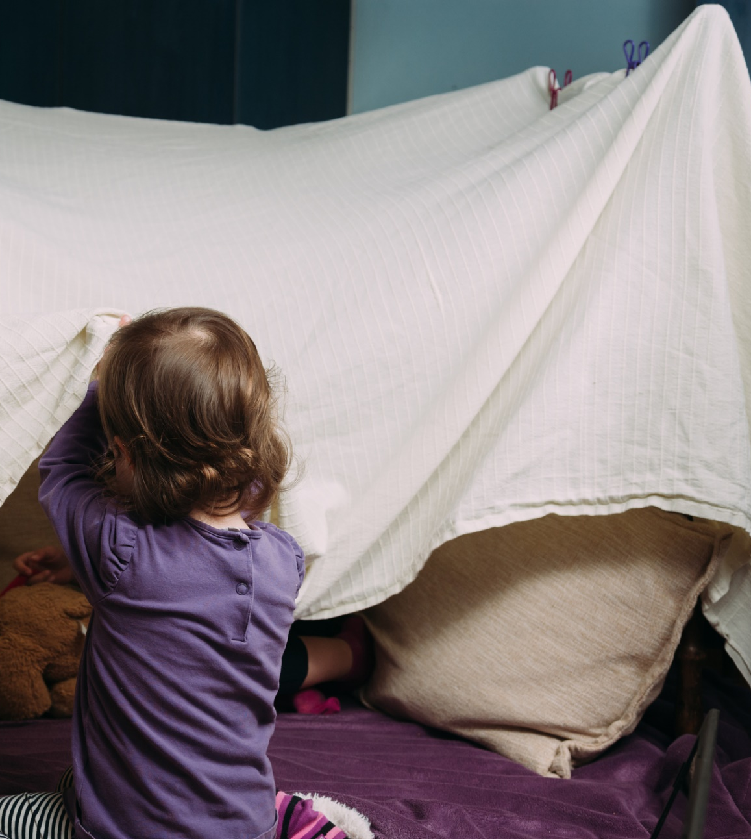
Example #3: Playing Fort
Two girls (under 10) made fort in childcare room
One took photos of other’s genitals
Allegedly digitally penetrated victim
Notes:
Talking Points:
Explain that two young kids were allowed to create a fort in a childcare room.
One used a functional toy camera to take photos of the other’s private parts.
There may also have been other sex acts involved.
Key Lessons to Emphasize:
Abuse can happen between younger children too.
Line of sight is central for prevention as even small, temporary obstructions create risk.
Optional Discussion Questions:
How can we prevent an incident like this from happening at our organization?

Slide 14
The Reality
The Assumption
Requires complete privacy
If staff or cameras are present we are safe
“I would see it and stop it”
Even small lapses in supervision are dangerous
Youth are good at not being detected
It can even happen in full view
Notes:
Purpose of Slide:
Emphasize that while some areas are riskier than others, abuse can happen anywhere.
Talking Points:
Run through and expand on the assumptions presented on the slide.
Explain that supervision is key to prevention—but that this requires active engagement, and constant vigilance.
Share that abuse cases can and do happen in full view of staff.
Optional Discussion Questions:
Do you think abuse could happen when you’re in the same room without you noticing? Why or why not?
Where might abuse happen even if we are in the same room?

Slide 15
Where and when does it happen?
Private locations: Bathrooms, locker rooms, cabins
Obstructions: Playground structures, closets, bus seats, underwater
Transition times: Transportation, sign-in/sign-out, beginning/end of day
Notes:
Purpose of Slide:
To highlight the most common locations where you will find peer-to-peer abuse—typically locations and times when youth think there is less supervision.
Talking Points:
Discuss general characteristics of locations—privacy and/or obscured views.
Discuss general characteristics of times—chaos/disorder/distraction or lack of supervision.
Emphasize that these are things to watch for—but nowhere is 100% safe. Think about the characteristics and look for them everywhere.
Optional Discussion Questions:
Where do you think youth might believe there is less supervision at our organization?
How can we structure transition times, so that youth are supervised 100% of the time?

Slide 16
Nowhere is ‘safe’
Any obstruction creates ‘privacy’
Towels, bus seats, furniture all create risk
Abuse happens on camera
Abuse happens w/ staff present
Notes:
Purpose of Slide:
This is an opportunity to emphasize the takeaway from the last slide: while there are danger spots, re-emphasize there are also no 100% ‘safe’ spots.
Talking Points:
Emphasize that risks in previous slide are things to watch for—but nowhere is 100% safe.
Remind them that abuse cases—even severe ones—have happened with staff in the room, or on camera.
Optional Discussion Questions:
What physical obstructions might make it hard to spot abuse specifically at your organization? How about environmental challenges—for example noise or crowds?

Slide 17
We can create a safe environment where abuse cannot happen.
Notes:
Purpose of Slide:
Having explained that staff need to be constantly vigilant, and that risks are everywhere, it is important to encourage staff that prevention is possible.
Talking Points:
Acknowledge how important it is to assume abuse is happening or has happened. But also acknowledge that this can be daunting/depressing.
Share the good news that simple, practical steps—if followed closely—can create environments where abuse can’t happen.
Optional Discussion Questions:
How is everyone feeling—nervous, discouraged, inspired? (Acknowledge any concerns, then explain that you’ll be moving on to cover practical tips to help them succeed.)

Slide 18
Engage Actively With Youth
Know your youth
Be curious, ask them how they are
Participate in activities—don’t just ‘watch’
Pay attention to changes in demeanor
Notes:
Purpose of Slide:
To focus on the idea of active, engaged supervision.
Talking Points:
Explain difference between passively ‘watching’ youth and active supervision.
Remind staff that this is about really knowing youth—building close but professional relationships to make it easier to spot any unusual or out-of-the-ordinary behavior.
This also builds trust so youth can feel safe to come forward.
Consider referring back to Example #2 (Teens Sneak Off), and pointing out that the teen who later disclosed abuse might have disclosed earlier if they had someone to talk to.
Optional Discussion Questions:
How have you been able to build real, authentic but professional relationships with youth?
What should we do if we do notice a change in demeanor in a youth?

Slide 19
Prevent Risky Situations
Be aware of personality types or conflict
Plan groups to avoid power imbalance
Follow supervision protocols
Do not allow alone time
Model healthy behaviors (e.g. no teasing, favoritism or bad language)
Notes:
Purpose of Slide:
Focus on broader prevention measures.
Talking Points:
Remind staff to be aware of power dynamics.
Emphasize importance of rules and supervision protocols such as no alone time. Consider referring back to Example #1. (Unsupervised Bathroom)
Emphasize importance of modeling behaviors like respect and open communication.
Optional Discussion Questions:
What should we do if we do notice a change in demeanor? Where are you most concerned abuse could happen at your organization? How might you make it safer?
How can we prevent alone time between two youth?

Slide 20
Identify Red-Flag Behaviors
Physical aggression or bullying
Sexualized language or behavior
Inappropriate touch
Youth sneaking off/seeking privacy
Notes:
Purpose of Slide:
In order to intervene, you have to know what abuse might look like and what behaviors can lead to abuse.
Talking Points:
Walk staff through the specific red-flags on the slide.
Make it very clear that no list can be exhaustive—some behaviors may be abusive that don’t look like it on paper. Consider referring back to Example #3 (Playing Fort) and pointing out it likely looked like innocent play.
Encourage staff to listen to their gut reactions and instincts.
Optional Discussion Questions:
What types of situations have you witnessed that might or might not be abusive?
How should we respond to these red-flag behaviors in the moment?

Slide 21
Stop Conflict Before it Escalates
Separate youth in conflict
Address teasing before it becomes bullying
Actively follow up with victims
Report concerns to supervisors
Notes:
Purpose of Slide:
Encourage a pro-active, anti-bullying stance—and make it clear that this is directly connected to abuse prevention.
Talking Points:
Reiterate the direct connection to bullying and the importance of stopping initial instances of bullying right away before it escalates.
Explain the need for victim-centered approach—the priority is helping the victim heal, not simply ‘making peace.’
Remind staff to follow all protocols and seek guidance.
Optional Discussion Questions:
How do we prevent bullying at our organization?
How do we stop bullying behavior immediately before it escalates into something worse?

Slide 22
When we are ready to respond, we become a lifeline for youth.
Notes:
Purpose of Slide:
Make sure that staff know that—even with best prevention—they may still have to respond to disclosure or discovery of abuse.
Talking Points:
Repeat that we can greatly reduce–and perhaps even eliminate—peer-to-peer abuse from our organizations.
But no organization is an island.
Whether at the organization—or in the community—someone may still disclose abuse.
We need to be ready.

Slide 23
How do you respond to abuse?
Separate youth
Say:
“I believe you.”
“I will help you.”
“It’s not your fault.”
Report to your supervisor immediately
Follow mandated reporter laws
Notes:
Purpose of Slide:
To cover the specifics of how to respond.
Talking Points:
Run through the main steps presented in the slide.
Explain that most of this is what you need to do if anyone discloses abuse—either adult-to-child or peer-to-peer.
Remind staff of the importance of putting the victim first—and on promoting healing.
Emphasize that they must notify supervisors, and also follow all mandated reporter laws.
Optional Discussion Questions:
How confident are you in responding to abuse? Let’s review our mandated reporter laws.
What challenges do you foresee in responding if someone does disclose abuse to you?

Slide 24
We must have zero tolerance for abuse.
Notes:
Purpose of Slide:
This is the closing slide, and the final takeaway.
Talking Points:
We encourage you to develop your own closing pitch for why this is important for your organization—but the key takeaway is that peer-to-peer abuse, like adult-to-child abuse, can ruin lives, create lasting damage and threaten the broader mission of the work you do. There is no place for such behavior at an organization dedicated to working with youth.

